Slide 1
INNER JOIN

Slide 2
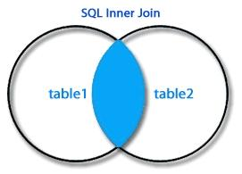
Returns The rows combining from one or more tables wherever there is a match on the joining column
The INNER JOIN keyword selects records that have matching values in both tables.

Slide 3
INNER JOIN Syntax:
SELECT column_name FROM table1 INNER JOIN table2 where table1.column_name = table2.column_name;
Table1
OrderID CustomerID EmployeeID OrderDate ShipperID 10308 2 7 1996-09-18 3 10309 37 3 1996-09-19 1 10310 77 8 1996-09-20 2

Slide 4
Table2
CustomerID | CustomerName | ContactName | Address | City | PostalCode | Country
1 | Alfreds Futterkiste | Maria Anders | Obere Str. 57 | Berlin | 12209 | Germany
2 | Ana Trujillo Emparedados y helados | Ana Trujillo | Avda. de la Constitución 2222 | México D.F. | 05021 | Mexico
3 | Antonio Moreno Taquería | Antonio Moreno | Mataderos 2312 | México D.F. | 05023 | Mexico

Slide 5
INNER JOIN Example
SELECT Orders.OrderID, Customers.CustomerName FROM Orders INNER JOIN Customers ON Orders.CustomerID = Customers.CustomerID;

Slide 6
Thank you

